Slide 1
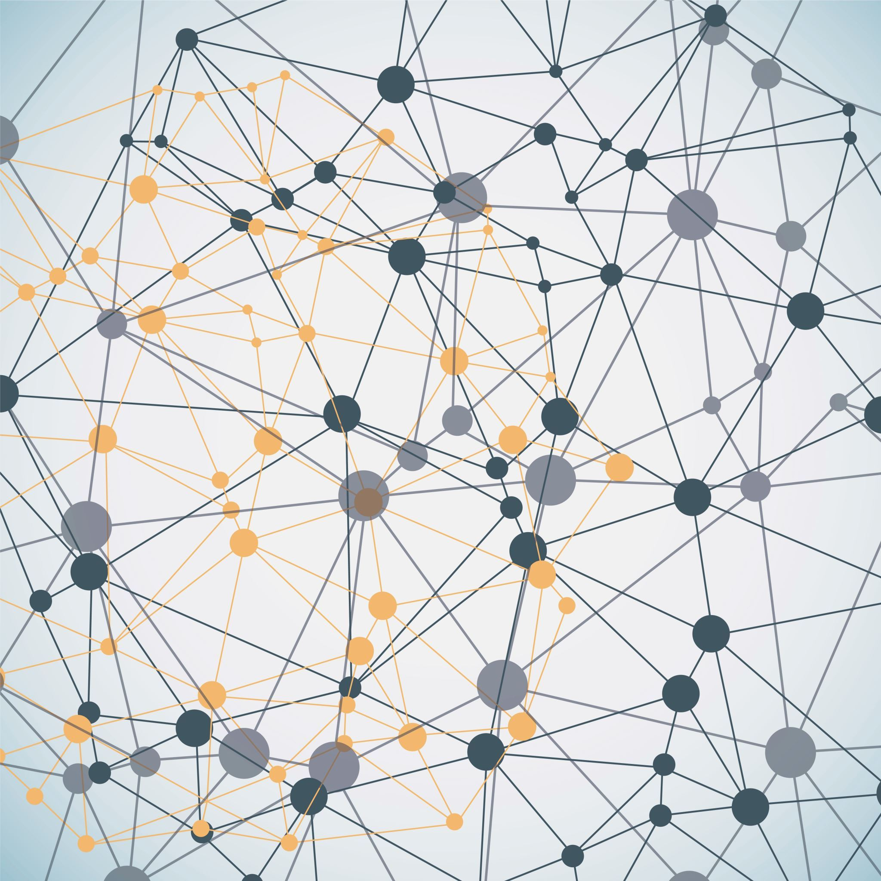
FUZZY SYSTEM INSPIRED BY SMART WATCH

Slide 2
Fuzzy Inference System: (How fuzzy system work )
Step (1): Identify the problem
1
Step (2): Define the input and output variables
2
Step (3): Define the membership functions
3
Step (4): Define the fuzzy rules
4
Step (5): Apply inference methods
5
Step (6): Select the defuzzification method
6
Step (7): Validate the system
7

Slide 3
Understanding Health Conditions:
Importance of health monitoring
Challenges in assessing overall health
Introduction to the fuzzy system approach
#Goal of the Fuzzy System
Develop a system for determining health conditions
Utilize linguistic variables for comprehensive assessment

Slide 4
Analysis of the original paper:
1. Fuzzy Variables
(Blood pressure-Temperature)
2. Membership Functions
(Trimf)
3. Outputs
(health condition)

Slide 5
Original paper code implementation:
# Create fuzzy variables
# Define membership functions for Blood Pressure
# Define membership functions for Temperature
# Define membership functions for Health Condition
# Plot the membership functions for Blood Pressure
# Plot the membership functions for Temperature
# Plot the membership functions for Health Condition
# Define rules
# Create control system
# Set input value
# Compute the result
# Print the result

Slide 6
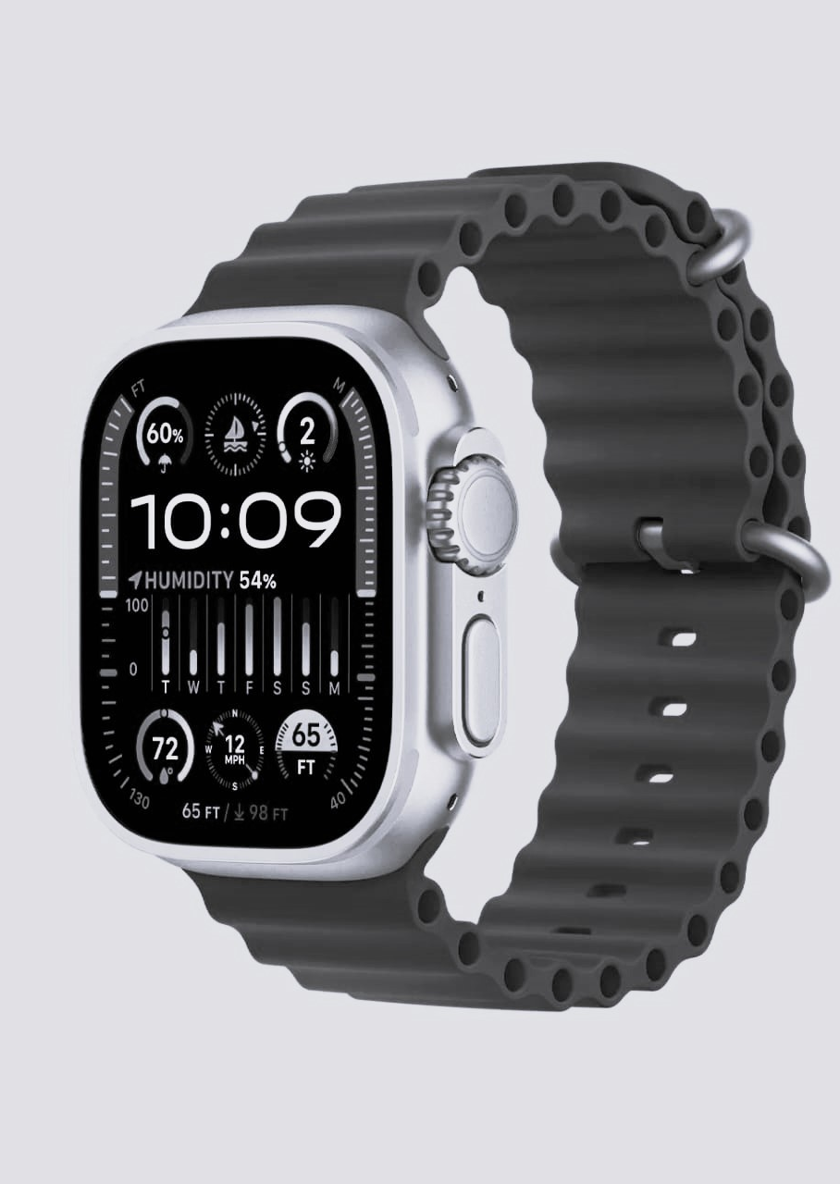
SYSTEM INSPIRATION:
This system modification is inspired from smart watch as it has the ability to monitor fitness activities, track health metrics like heart rate and sleep patterns, provide workout guidance, health condition ,and blood pressure monitoring.
Imagelink:https://media.wired.com/photos/6511aab1189c419c40374c92/1:1/w_1358,h_1358,c_limit/Apple-Watch-Ultra-2-Alt-Gear.jpg

Slide 7
Modifications & contributions:
Fuzzy variables : Add(Age-O2 percentage-Sleep quality-Heart rate) .
MemberShip Function : (Trimf) Adding membership function for new inputs .
Output:(health condition) .
Increasing number of rules : Possible number of rules is 2025 And used 150 rule .

Slide 8

Proposed code:
This Python code uses fuzzy logic to model health conditions based on input parameters like blood pressure, temperature, age, oxygen percentage, sleep quality, and heart rate. It defines membership functions, visualizes them, and establishes rules for health condition classification. The code then simulates the system with specific inputs and visualizes the inferred health condition.

Slide 9
Comparison:
features | Original paper code: | Modified Code:
Number of Inputs: | Two (BP and TEMP) | Six (BP, TEMP, Age, O2_percentage, Sleep_quality, Heart_rate)
Number of Rules: | Used rules 6 of 25 rule | Used rules 150 of 2025 rule
Code Readability: | Simple and concise | More complex due to additional inputs and rules
Application Focus: | Basic health condition assessment | Comprehensive health condition assessment
Number of Membership Functions (per input): | BP (5), TEMP (5) | BP (5), TEMP (5), Age (3), O2_percentage (3), Sleep_quality (3), Heart_rate (3)
Input values : | ['BP'] = 130 ['TEMP'] = 102 | ['BP'] = 130 ['TEMP'] = 102 ['Age'] = 45 ['O2_percentage'] = 92 ['Sleep_quality'] = 7 ['Heart_rate'] = 80

Slide 10
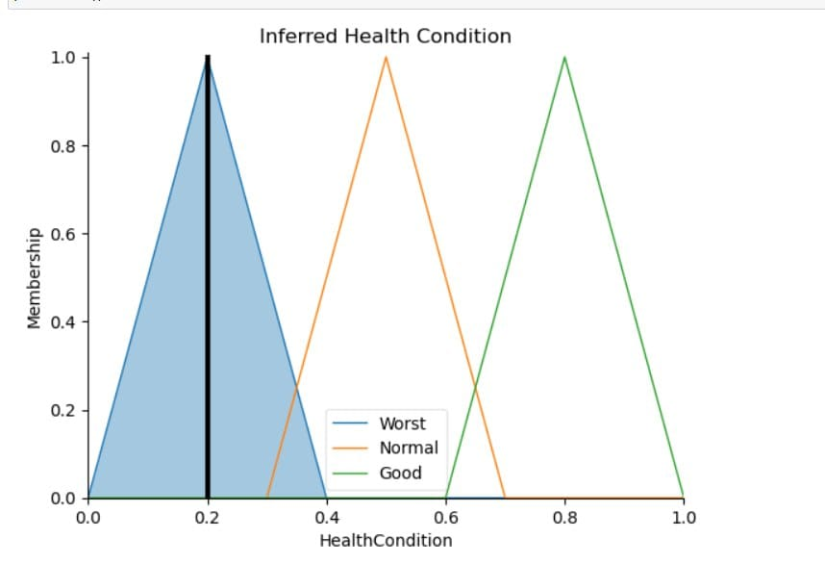
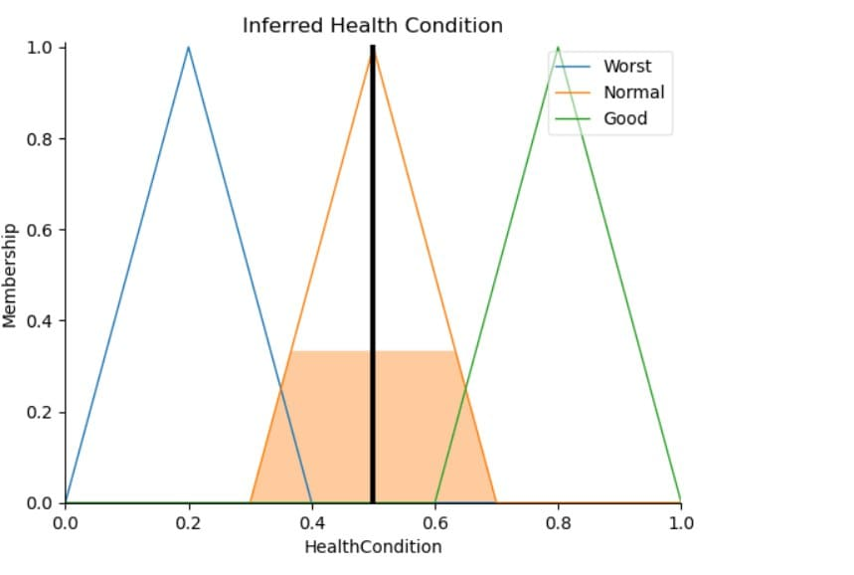
Comparison:

Slide 11
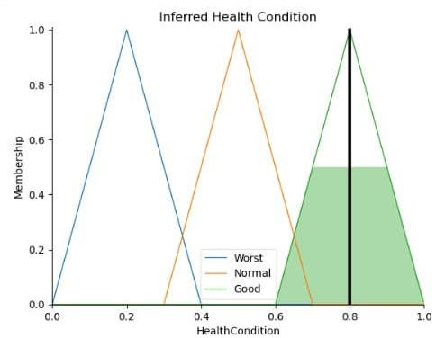
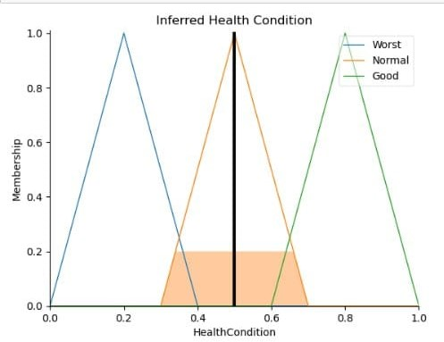
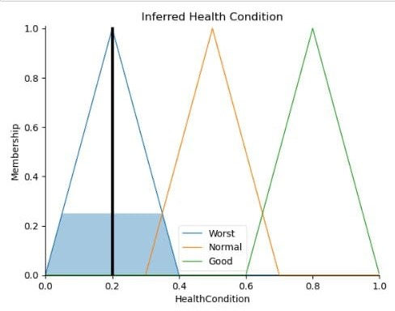
INPUT EXAMPLE 1: | INPUT EXAMPLE 2: | INPUT EXAMPLE 3:
health_classification.input['BP'] = 110 health_classification.input['TEMP'] = 98.6 health_classification.input['Age'] =25 health_classification.input['O2_percentage'] = 98 health_classification.input['Sleep_quality'] = 8 health_classification.input['Heart_rate'] = 65 | health_classification.input['BP'] = 125 health_classification.input['TEMP'] = 100.5 health_classification.input['Age'] = 45 health_classification.input['O2_percentage'] = 94 health_classification.input['Sleep_quality'] = 6 health_classification.input['Heart_rate'] = 80 | health_classification.input['BP'] = 140 health_classification.input['TEMP'] = 105 health_classification.input['Age'] =55 health_classification.input['O2_percentage'] = 88 health_classification.input['Sleep_quality'] = 4 health_classification.input['Heart_rate'] = 95

Slide 12
Team members: shimaa said hosny 2205187 habiba tarek nassar 2205188 nour shrief mohamed 2205061 alaa omar aboelmagd 2205013

Slide 13
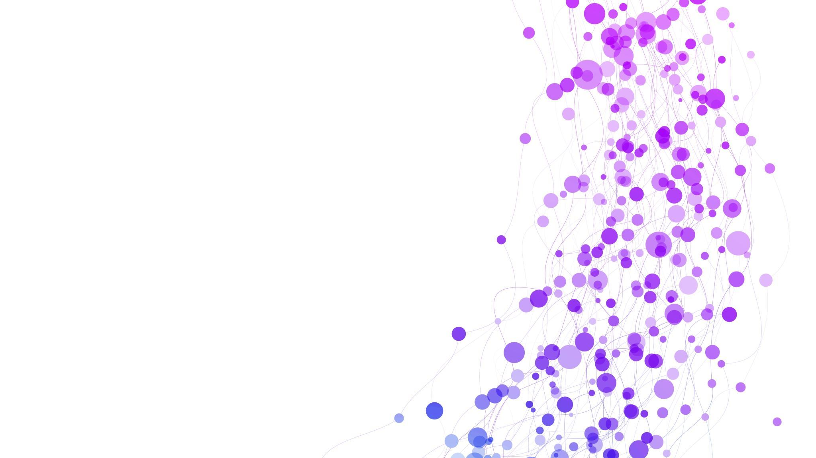
Thank you ….

